Slide 1

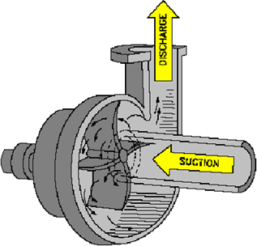
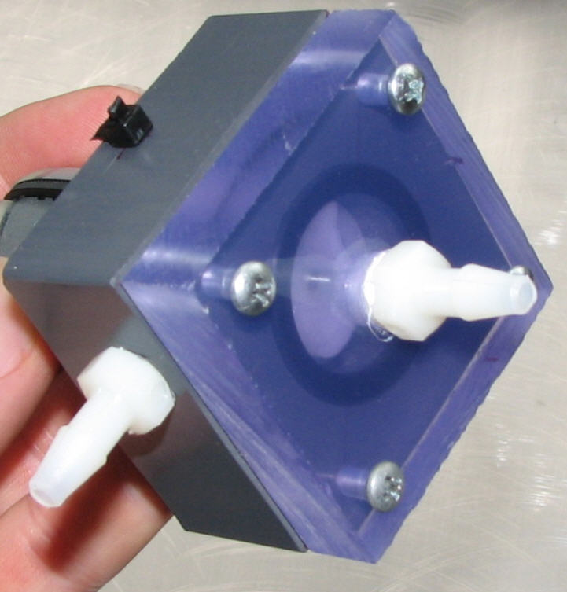
living with the lab
Fabrication of a Centrifugal Pump

Slide 2
living with the lab
DISCLAIMER
The content of this presentation is for informational purposes only and is intended only for students attending Louisiana Tech University.
The author of this information does not make any claims as to the validity or accuracy of the information or methods presented.
The procedures demonstrated here are potentially dangerous and could result in injury or damage.
Louisiana Tech University and the State of Louisiana, their officers, employees, agents or volunteers, are not liable or responsible for any injuries, illness, damage or losses which may result from your using the materials or ideas, or from your performing the experiments or procedures depicted in this presentation.
If you do not agree, then do not view this content.

Slide 3
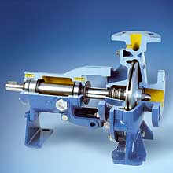

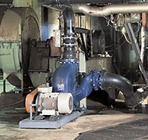
living with the lab
Examples of Centrifugal Pumps
www.grpumps.com
www.oilworksinc.com

Slide 4
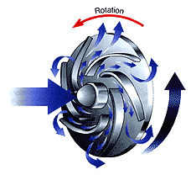
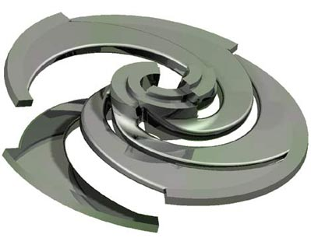
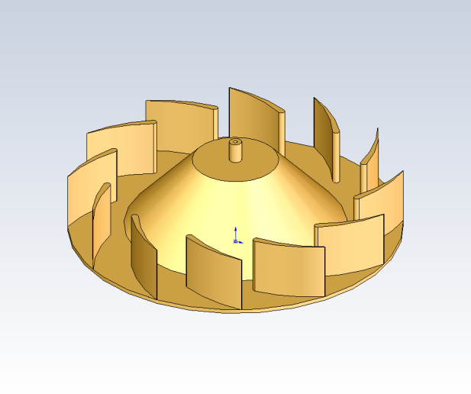
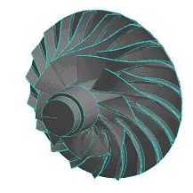
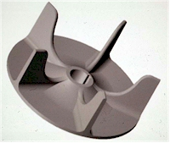
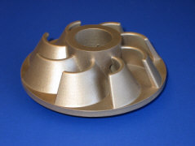
living with the lab
Examples of Impellers

Slide 5
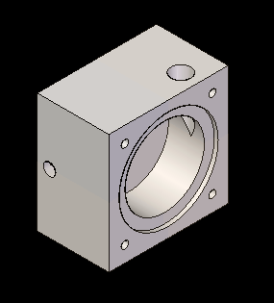
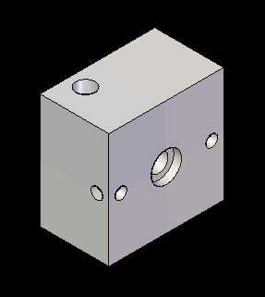
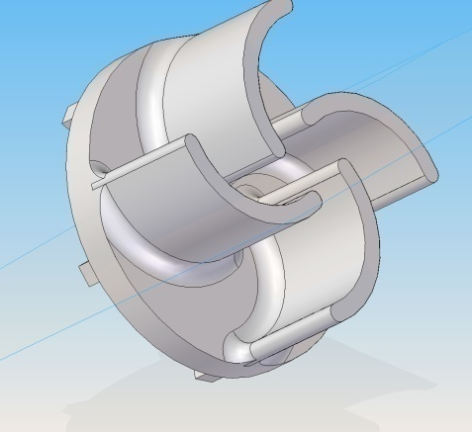
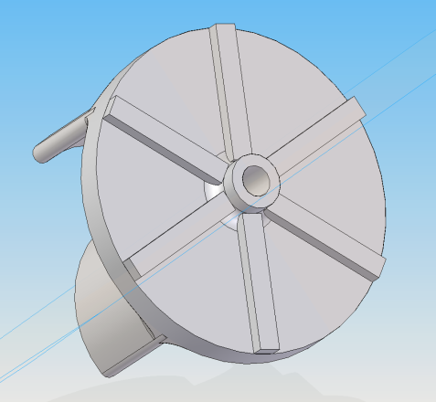
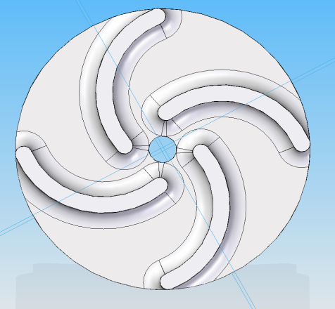
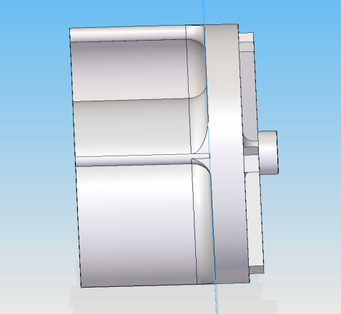
living with the lab
Parts to Fabricate
Impeller
Fabricated Using a Rapid Prototyping
Machine from ABS Plastic
Pump Body
Fabricated from PVC rod.

Slide 6
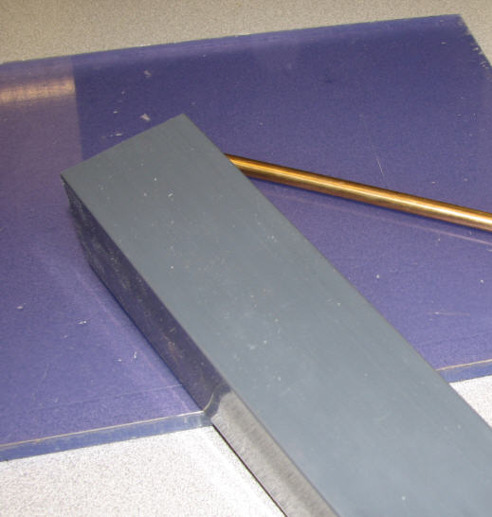
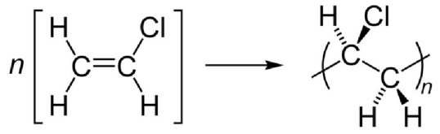
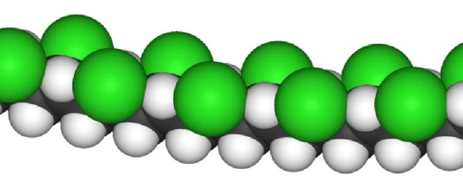

living with the lab
Raw Materials
PVC = polyvinyl chloride
½” thick blue-tint PVC sheet
$26.29 per square ft
5/16” bronze rod
$6.89 per ft
PVC is made of long chain molecules with a carbon backbone and hydrogen and chlorine side groups
2” x 2” gray PVC rod
$16.23 per ft
Ultra-Machinable High-Strength Bearing-Grade Bronze (Alloy 544) Bronze is primarily an alloy of copper and tin. This bronze contains lead, making it easier to machine.

Slide 7
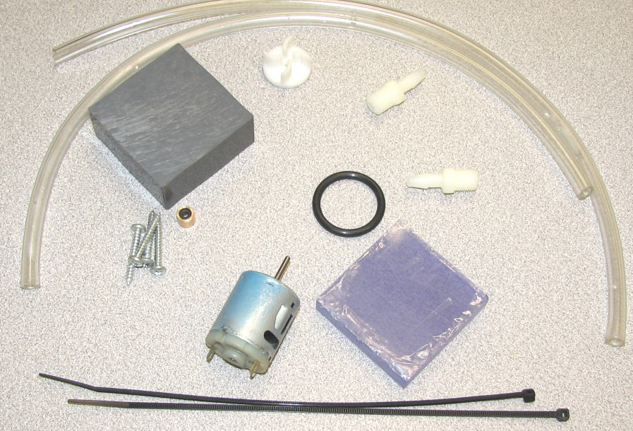
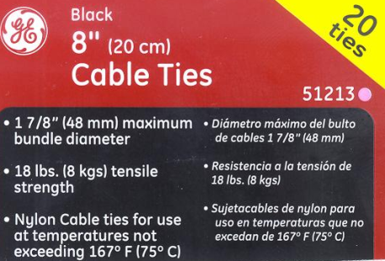
living with the lab
Parts and Materials Required for Pump

Slide 8
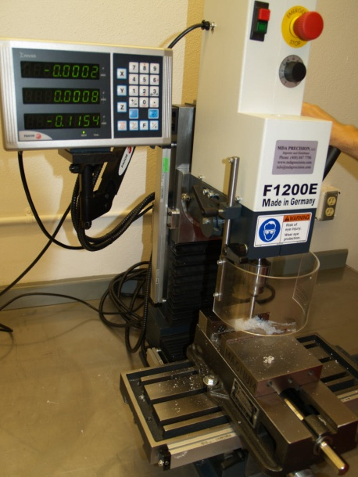
living with the lab
Tools
You must become familiar with the operation and safety procedures of the tools before beginning the project.

Slide 9







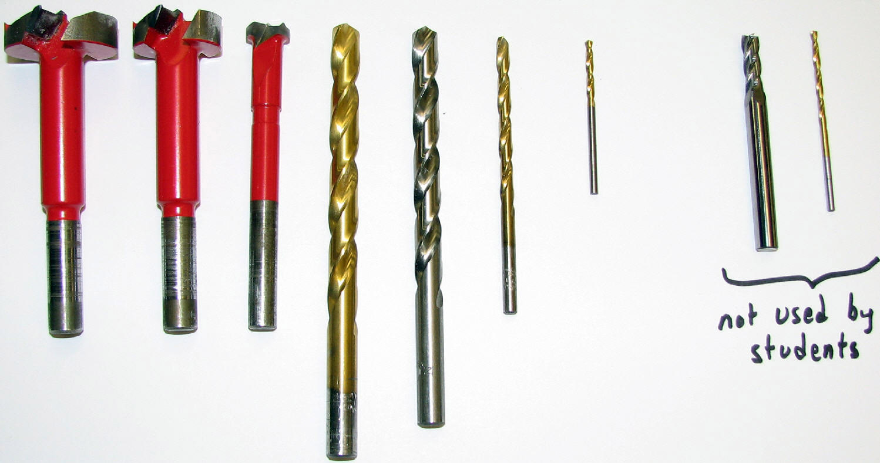
living with the lab
Drill Bits
End Mill
for sizing
Impeller hole
Forstner bits
for bushing/seal

Slide 10
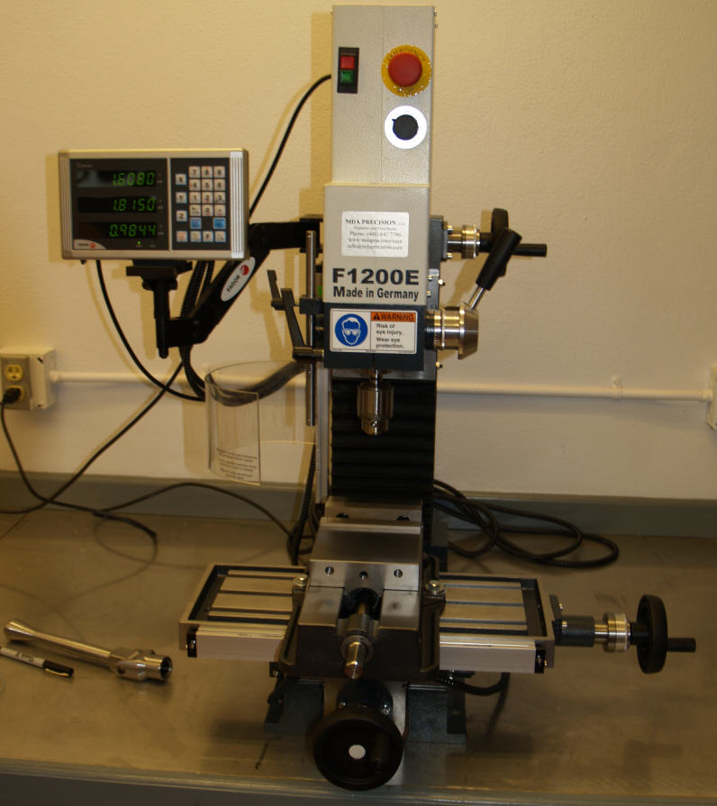
living with the lab
Milling Machine: Prepare Machine for Use
Clean and inspect the machine. Inform your instructor if you find any potential damage. To clean, apply a small amount of oil to the x-y table and vise surfaces, and wipe them down with a clean cloth. The oil will keep the unpainted steel surfaces from rusting and will reduce wear on the moving surfaces of the vise.
milling vise
xy table

Slide 11
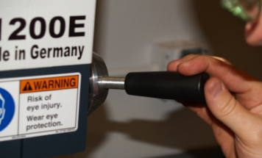
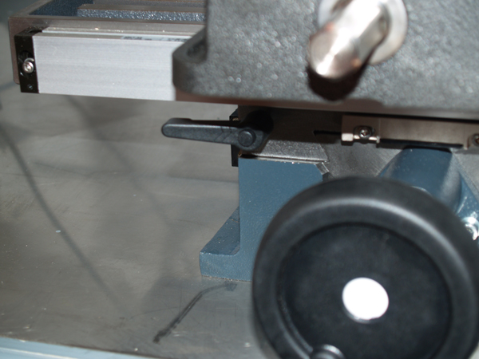
living with the lab
Milling Machine: Operating the Digital Readout (DRO)
Practice moving each of these handles back and forth with the machine turned off until you understand and feel comfortable with machine movements.
digital readout (DRO) – used to monitor the
x, y and z positions due to turning the 3 crank handles
z-direction
crank handle for z-translation
of entire cutting head assembly
spindle handle for z-translation
of spindle only (drill chuck only)
(DOES NOT AFFECT DRO READOUT)
Make sure lock bolt for x-direction
stage is unlocked an turned upward so that it won’t interfere with table movement (or it could break off)
z-direction
y-direction
x-direction
crank handle
for x-translation
crank handle
for y-translation

Slide 12
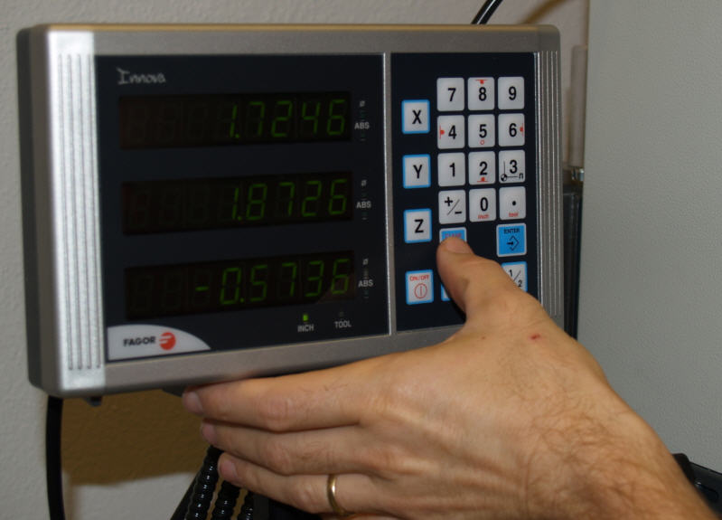
living with the lab
Milling Machine: Operation of the Digital Readout (DRO)
The z-direction readout on the DRO is used to tell you how deep you are drilling. The x- and y-direction readouts can help you accurately position the holes in the faceplate and the pump exit hole. Note that the crank handles for the x, y and z directions cause the DRO values to change, but the spindle handle does not influence DRO readout. To clear the x-reading on the DRO, press <clear> followed by <x>; do likewise for the y and z directions.
clear button (the one being pushed)

Slide 13
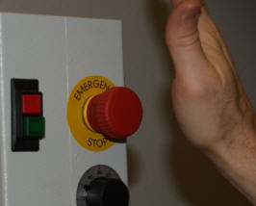
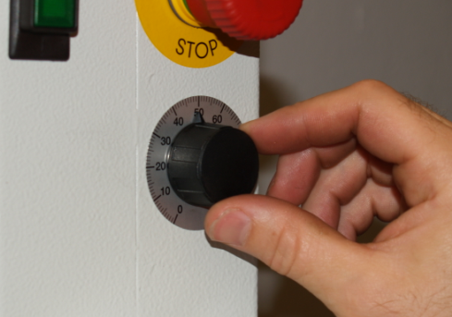
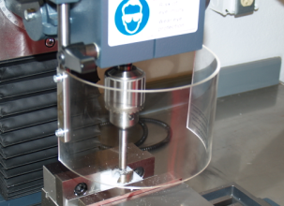
living with the lab
Milling Machine: Safety Features and Operation
With the safety shield closed and your safety glasses on, practice turning the machine on and off (turn off with both the off button and the emergency stop). Practice changing the speed of the spindle.
red off button
emergency stop (hit
this button to quickly
stop machine)
green on button
Safety Shield: Do not start machine if this shield is not in place. Be sure that there is adequate clearance between the bottom of this shield and the top of the milling vise before adjusting the crank handle for z-translation of the cutting head assembly.
Spindle Speed Control: Use the speeds
recommended for each drilling operation

Slide 14
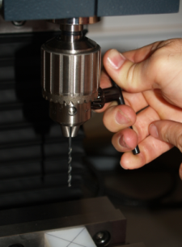
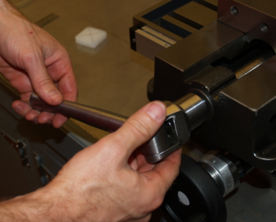
living with the lab
Milling Machine: Loading a Workpiece into the Vise and Tool into the Chuck
Place the parallels into the vise followed by the workpiece. Then, use the vise handle to tighten the slide on the milling machine. Make sure the workpiece is securely clamped in the vise before beginning work.
nut for locking down
x stage of x-y table (be careful not to move the y-stage if this nut is downward (make sure it’s pointing upward), or you could break off the nut.
load drill bit or other
tool into chuck and
tighten with key
Don’t forget to
Remove key
from chuck!
vise handle

Slide 15
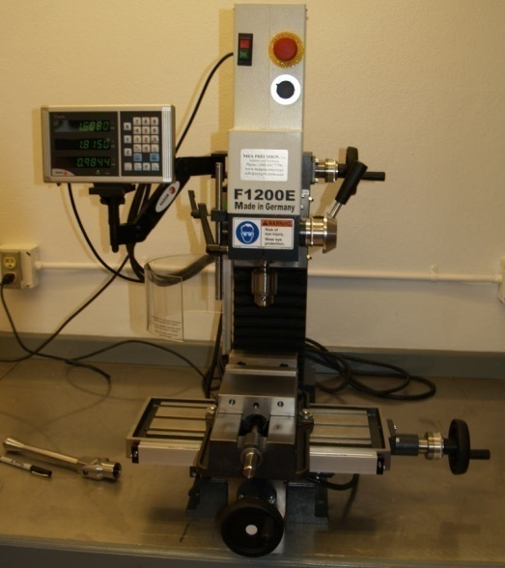

living with the lab
Safety Rules
Do not operate any machine unless authorized to do so by the instructor.
Do not attempt to oil, clean, adjust or repair any machine while it is in operation.
Wear appropriate clothing for the work to be done – loose clothing can be caught up in rotating equipment, pulling you into the equipment.
No “horse play” is allowed in the lab.
To prevent tripping or cutting a foot, keep floor clear of scraps, chips and supplies.
Turn off the equipment you are using before leaving it.
Safety glasses or a face shield must be worn when using tools or equipment.
Put tools away when not in use.
Do not use rags on rotating work.
Do not attempt to hold work with rags while using any rotating equipment.
Long hair must be tucked under a cap when you are operating rotating equipment.
Report any unsafe working conditions and/or practices to the instructor.
Take all common sense precautions. If you have an accident, report it immediately to the instructor.
Do not begin to fabricate your pump until you have carefully read the operating and safety instructions above and agree to operate the equipment in a responsible manner. You must sign the safety contract before beginning fabrication.

Slide 16
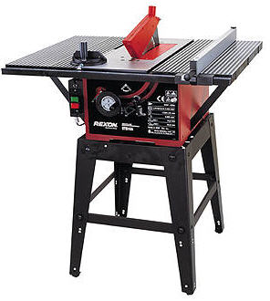
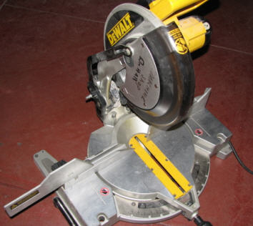
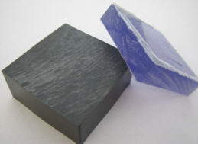
living with the lab
The operations below are performed by University technicians
(do not do this yourself).
Rip the PVC sheet into 2 inch wide strips using a table saw. Then, chop these strips into 2 inch long segments for the pump face plate using a chop saw.
Saw the 2 inch x 2 inch PVC rod into a 0.9 inch long segment for the pump body using a chop saw.
raw materials
table saw
chop saw
materials after cutting

Slide 17
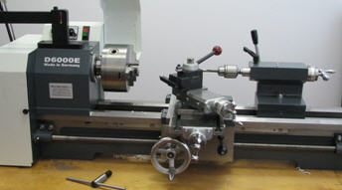
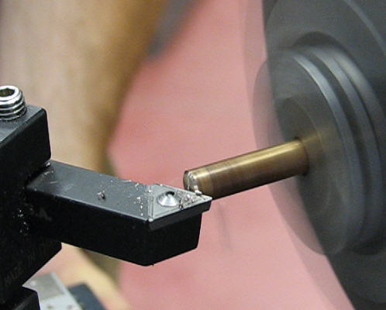
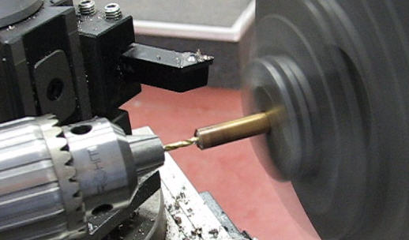
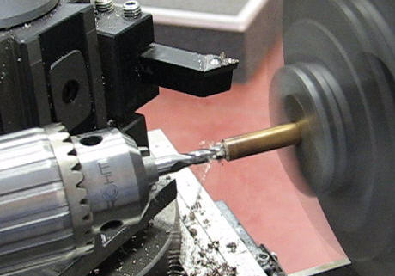
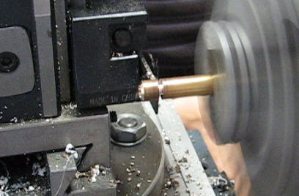
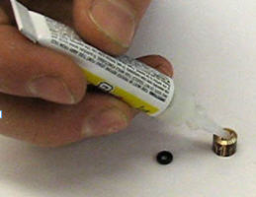
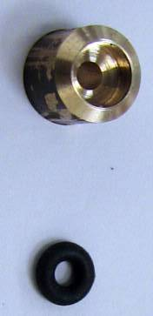
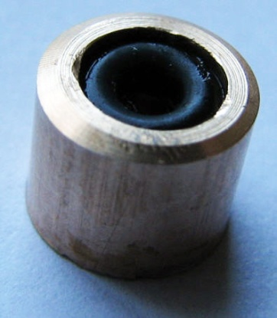
living with the lab
Bushing and Seal: University technicians have fabricated a bushing and seal to prevent your pump from leaking around the DC motor shaft. The seal is made from a bearing grade bronze rod and a small o-ring. The bronze rod is prepared using a lathe, which you will learn to use in ENGR 121.
lathe
STEP 1: bevel bronze rod
STEP 2: center drilling with #42 bit
STEP 3: make o-ring seat with 13/64 end mill
STEP 4: parting bronze rod
STEP 5: glue in o-ring
finished bushing / seal

Slide 18
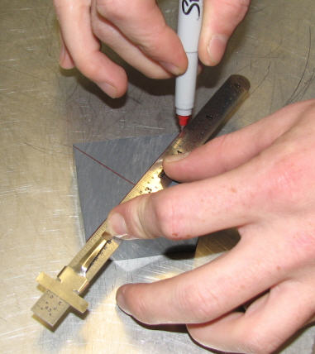
living with the lab
Draw an X on the top of the block to find the center

Slide 19
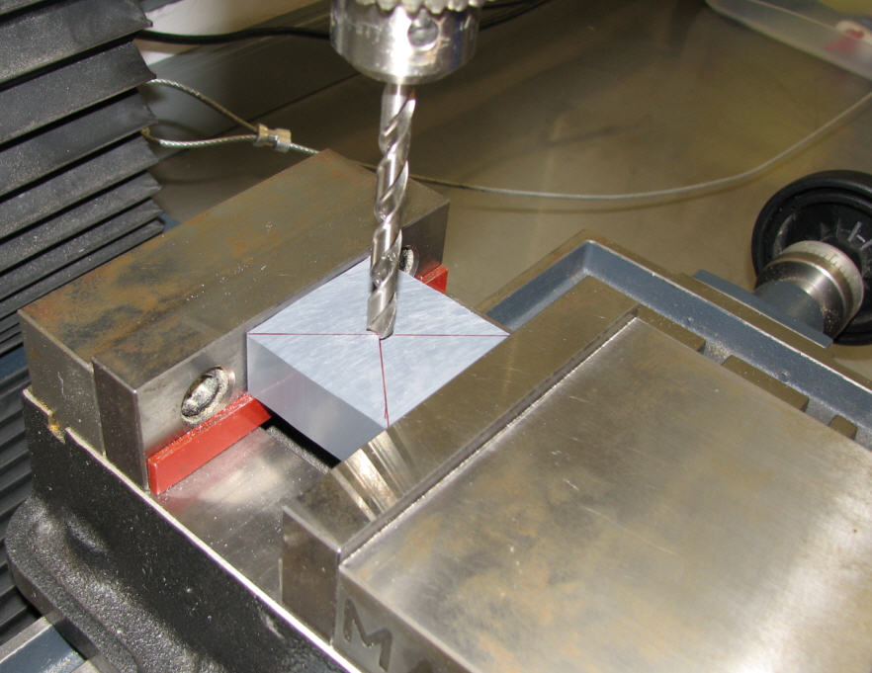
living with the lab
Clamp the block into the milling vise – make sure the parallels are supporting the workpiece.
parallels

Slide 20
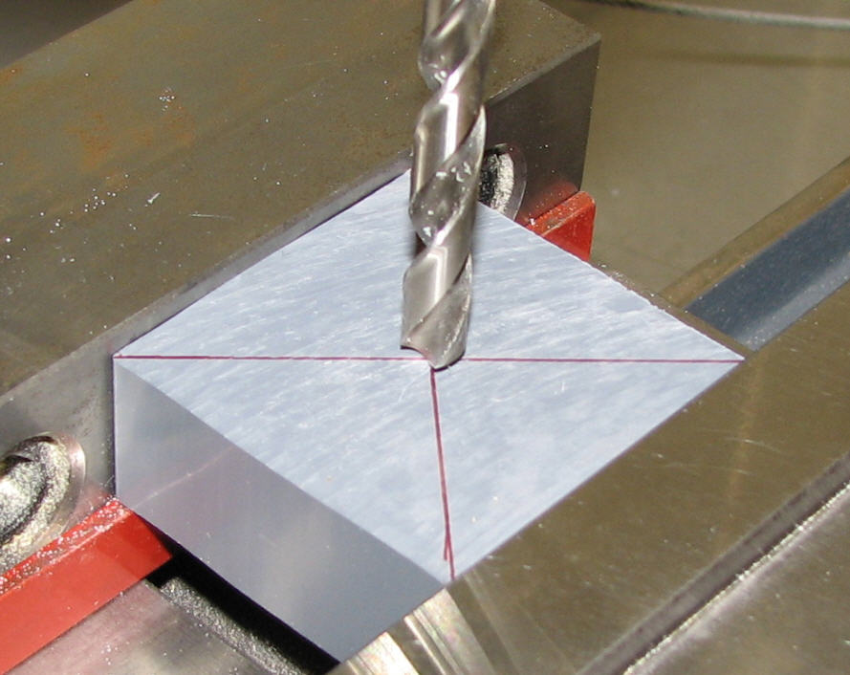
living with the lab
Put the N bit into the chuck. Turn the crank handles to move the x-y table until the bit is directly over the “x.” Then tighten down the x- and y-table lock bolts so the table won’t move in the subsequent steps. The lock bolts can get hung up on the x-y table when you are moving it, so check to make sure there isn’t any interference.
lock bolt for x-direction

Slide 21
living with the lab
Drill N bit hole all the way through block (but not into the vise!!!).
You can use either the crank handle or the spindle handle.
Note: Set the drilling speed to 40.
crank handle for z-translation
of entire cutting head assembly
spindle handle for z-translation
of spindle only (drill chuck only)
(DOES NOT AFFECT DRO READOUT)

Slide 22
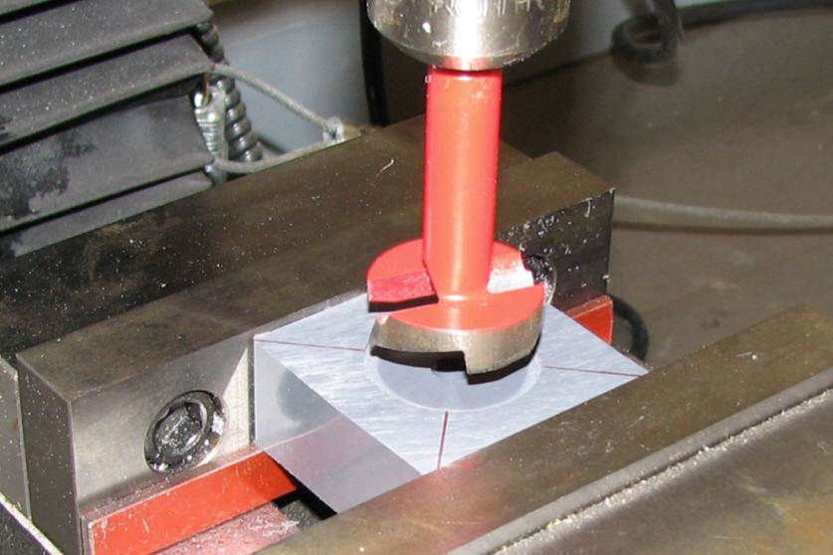
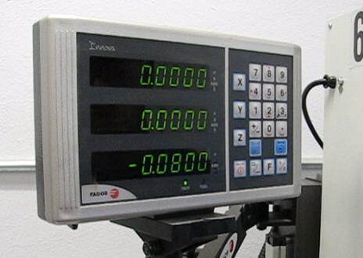
living with the lab
Install the 1 ¼ inch Forstner bit into the chuck. You may need to raise the cutting head to provide room to get the bit into the chuck. After the bit is in and the safety shield is in place, turn the spindle on. Then, lower the cutting head with the z-crank handle until the bit begins to cut the 1 ¼ inch hole. Zero the z-direction on the DRO, and drill down until the depth is about 0.080 inches.
Note: Set your drilling speed to 30

Slide 23
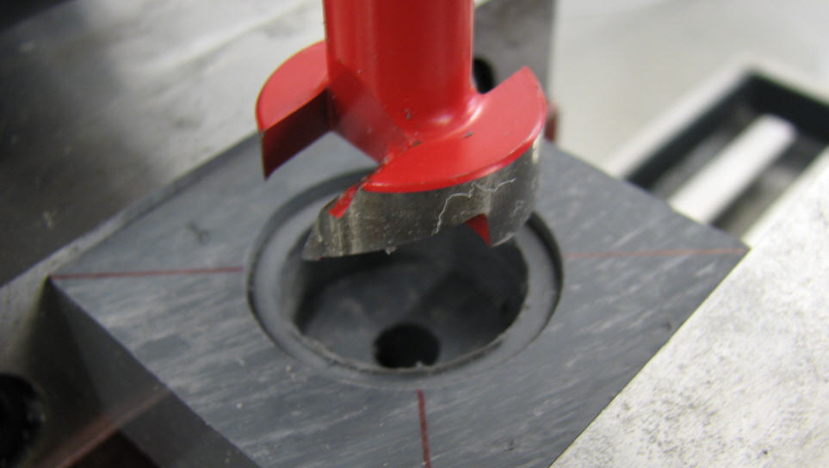


living with the lab
Install the 1 inch Forstner bit, bring the cutting head down until the bit begins to cut into the block at the bottom of the previous hole. Drill an additional 0.42 inches deeper (for a total depth of ½ inch from the top surface of the block).
Note: Set your drilling speed to 30
Expect chips to wrap around the bit during drilling
Warning – The drill bit may be very hot. Use a rag or cloth to remove.

Slide 24

living with the lab
Unlock the x- and y-stage lock bolts and remove the block from the vise. Flip the pump body over, doing your best to be sure the axis of the hole drilled earlier coincides with the axis of the spindle. To check this, place the N bit back into the chuck, and move the x- and y-stages until the bit is aligned with the hole. Now, remove the N bit and replace it with the ½ inch Forstner bit.

Slide 25

living with the lab
Drill a hole 0.11 inches deep using the ½ inch Forstner bit – the DC pump motor will be mounted to this side of the pump body.
Note: Set your drilling speed to 40

Slide 26



living with the lab
Mark hole for pump outlet as shown below. The exit should roughly be tangent to the 1 inch Forstner hole.
drill hole here
bit is tangent to 1 inch hole
5/16 inch
11/16 inch

Slide 27
living with the lab
Drill the pump exit hole with the Q bit to a depth of 1 inch.
Note: Set your drilling speed to 40

Slide 28


living with the lab
Mark the locations of the four holes to attach the DC motor to the pump body.
3/16 inch
3/8 inch
1 inch

Slide 29


living with the lab
Drill the four holes to attach the DC motor to the pump body using the 5/32 inch bit.
Note: Set your drilling speed to 50
The hole being drilled in this picture should be 1/4 inch deep.
The hole being drilled in this picture should be 7/16 inch deep.

Slide 30

living with the lab
Tap pump exit for a barbed fitting to attach tubing. Place the pump body in the bench vise for tapping.
You will need to apply a little bit of axial force to the tap as you get it started in the hole. While you are doing this, keep checking to be sure your tap is perpendicular to the pump body.

Slide 31


living with the lab
Press the bronze bushing with the o-ring seal into the pump body until the bushing is flush with the bottom of the 0.11 inch diameter hole. Completely close the jaws of the chuck, and use the z-crank handle to apply the pressing force.
We normally don’t use the milling machine as a press, but it’s OK here since pressing forces are small.

Slide 32

living with the lab
Make an X on the face place to prepare for drilling. Go ahead and also mark the location of the four screw holes.
¼ inch
¼ inch

Slide 33

living with the lab
Using the milling machine, drill the pump inlet hole with a Q bit all the way through face plate as shown. Be sure to support the face plate with the parallels.
Note: Set your drilling speed to 40

Slide 34

living with the lab
Using the milling machine, drill the four screw holes into the face plate using a #42 drill bit.
Note: Set your drilling speed to 50

Slide 35

living with the lab
Tap 1/8 inch 27 NPT threads into the face place.

Slide 36



living with the lab
Make alignment marks on the pump body and face plate.
Clamp the pump body to the pump face plate as shown.
Cutting marks into work pieces keeps them from rubbing off.
Place the clamped parts in the bench vise as shown, and make alignment marks so you can properly align the face plate to the pump body during later assembly steps.
alignment marks

Slide 37

living with the lab
Leave the clamped parts in the bench vise. Using the four holes in the face plate as a guide, drill #42 holes deep into pump body (don’t go quite all the way through) using a hand drill (this is not done in the milling machine).
Be sure to keep the drill perpendicular to the workpiece to avoid breaking the drill bit.
NOTE: The drill is variable speed; practice using the drill without a bit first trying to keep the rotational speed of the drill low for safety. Work toward slow and controlled motion (don’t put your body weight into the drill since suddenly breaking through the workpiece is dangerous). Never use the hand drill unless the workpiece is clamped in the vise.

Slide 38


living with the lab
Mount the face plate in the vise. Chase the #42 holes in the face plate with a 5/32 inch bit using a hand drill to provide clearance between the screw and the face plate.
d
d_{hole} > d_{screw}
d_{screw}
d_{hole}
Important: Oversizing these holes allows the screws to easily slide through. The o-ring between the faceplate and body can’t be properly compressed unless these holes have a diameter larger than the screws.

Slide 39


living with the lab
Apply Teflon tape to the two barbed fittings, and then screw them into the pump body and into the face plate. Teflon tape helps prevent leaking.

Slide 40


living with the lab
Use the two zip ties to attach the DC motor to the pump body.
Note: The bronze bushing keeps the axis of the DC motor shaft concentric with the o-ring seal. The seal is attached to the bushing with super glue. If the DC motor shaft doesn’t easily slip into the bushing/seal, then use the #42 drill bit to clean out the bushing hole since excess superglue may have accumulated in the hole during gluing. There is no need to use a drill; you should be able to turn the bit in the hole by hand. Be careful not to remove too much of the o-ring material since this could lead to leakage.

Slide 41

living with the lab
Lubricate around the o-ring, being careful not to get lubricant on the motor shaft (since the impeller might slip relative to the pump shaft if the contact interface is lubricated).
When using the pump later, be careful not to run the pump dry, since the o-ring seal could get too hot and be damaged, resulting in a leaky pump.

Slide 42


living with the lab
Press the impeller onto the shaft of the DC motor, being careful not to break the impeller blades (press straight down with uniform force).
The hole in your impeller was sized using a #44 drill bit for a 0.005 inch interference fit between the impeller and the DC motor shaft.

Slide 43



living with the lab
Complete the assembly of the pump.
keep gap uniform
Screw down the four screws until you compress the o-ring enough to prevent leaks. Make sure you have a uniform gap between the pump body and the face plate.

Slide 44



living with the lab
Clean up your mess. Make it look better when you leave than it looked when you arrived. Take pride in your lab!!!
Step 1: Brush the larger chips off the machine and vises, collecting them in the dustpan. Dispose of them in the trashcan.
Step 2: Vacuum up any remaining small chips (do not vacuum large chips since it will plug up the vacuum cleaner.
Step 3: Wipe the machine and the countertop in your area with a rag (an oily rag will keep the milling machine from rusting).
Step 4: Put all drill bits and the chuck key back into their holder and organize your work area. Inform your instructor is anything is broken, damaged or lost before leaving the classroom.

Slide 45

living with the lab
Show the instructor your pump and that your workstation is put back in order.

